Slide 1

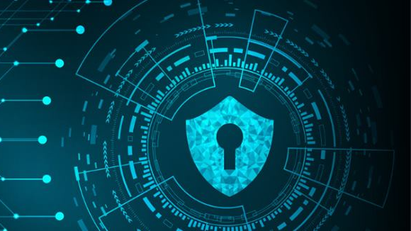
Digital Forencics

Slide 2
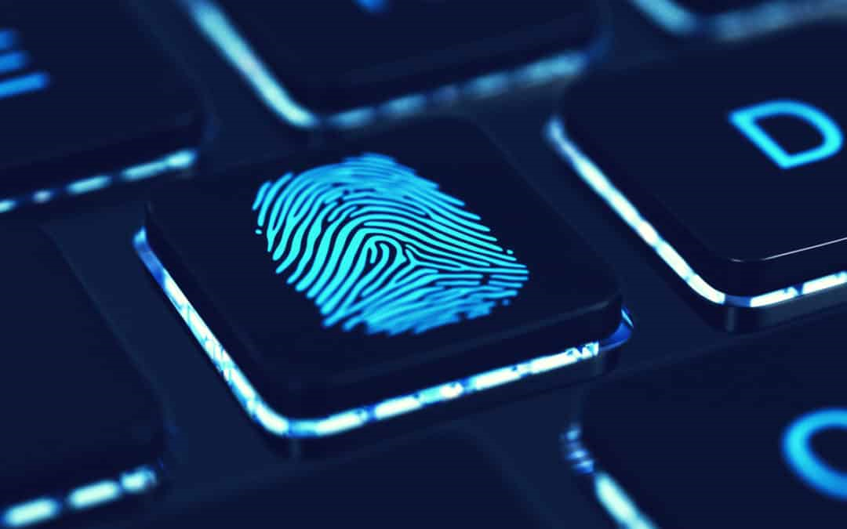
Digital Forencics
Contens
► What is Digital Forensics?
► Objectives of Digital Forensics
► Process of Digital Forensics
► Types of Digital Forensics
► Challenges faced by Digital Forensics
► Example Uses of Digital Forensics
► Advantages of Digital Forensics
► Disadvantages of Digital Forensics

Slide 3
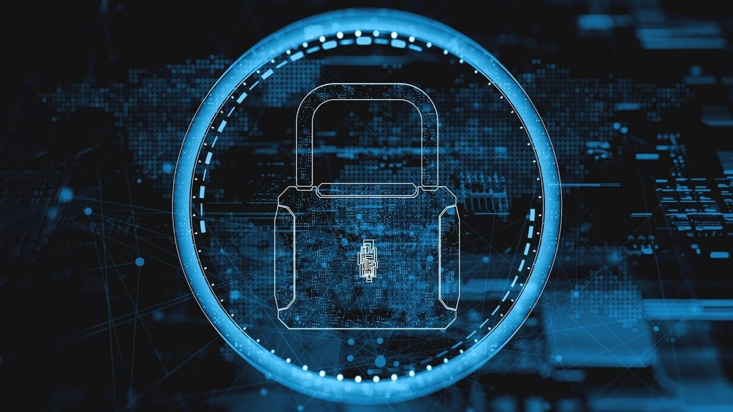
What is Digital Forensics?
Digital Forensics is defined as the process of preservation, identification, extraction, and documentation of computer evidence which can be used by the court of law. It is a science of finding evidence from digital media like a computer, mobile phone, server, or network. It provides the forensic team with the best techniques and tools to solve complicated digital-related cases.

Slide 4
Objectives of Digital Forensics Here are the essential objectives of using Digital Forensics:
It helps to recover, analyze, and preserve computer and related materials in such a manner that it helps the investigation agency to present them as evidence in a court of law.
It helps to postulate the motive behind the crime and identity of the main culprit.
Recovering deleted files from digital media to extract the evidence and validate them.
Helps you to identify the evidence quickly
Preserving the evidence.

Slide 5
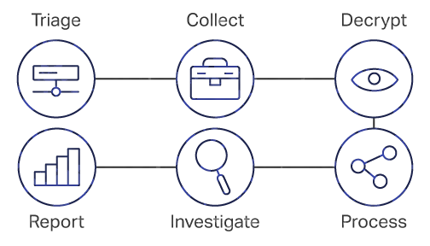
Process of Digital forensics
Identification:
Preservation:
Analysis:
Documentation:
Presentation:
İdentify the purpose of investigation
İdentify the resources required
Data is isolate,secure and preserve
İdentify tool and techniques to use
Process data
İnterpret analysis results
Documentation of the crime scene along with photographing, sketching, and crime-scene mapping
Process of summarization and explanation of conclusions is done with the help to gather facts

Slide 6
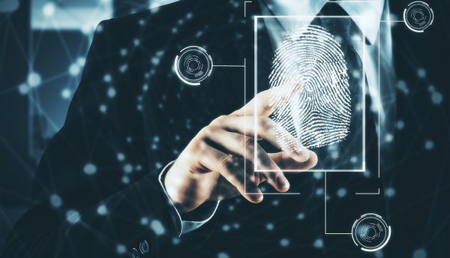
Types of Digital Forensic
Disk Forensics
Network Forensics
Wireless Forensics
Database Forensics
Malware Forensics
Email Forensics
Memory Forensics
Mobile Phone Forensics

Slide 7

Challenges faced by Digital Forensics
Here, are major challenges faced by the Digital Forensic:
The increase of PC's and extensive use of internet access
Easy availability of hacking tools
The large amount of storage space into Terabytes that makes this investigation job difficult.
Any technological changes require an upgrade or changes to solutions.

Slide 8

Example Uses of Digital Forensics
Intellectual Property theft
Industrial espionage
Fraud investigations
Inappropriate use of the Internet and email in the workplace
Forgeries related matters
Issues concern with the regulatory compliance

Slide 9
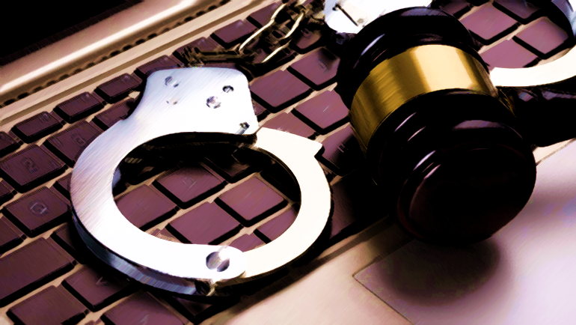
Advantages of Digital forensics
To ensure the integrity of the computer system.
To produce evidence in the court, which can lead to the punishment of the culprit.
It helps the companies to capture important information if their computer systems or networks are compromised.
Efficiently tracks down cybercriminals from anywhere in the world.

Slide 10
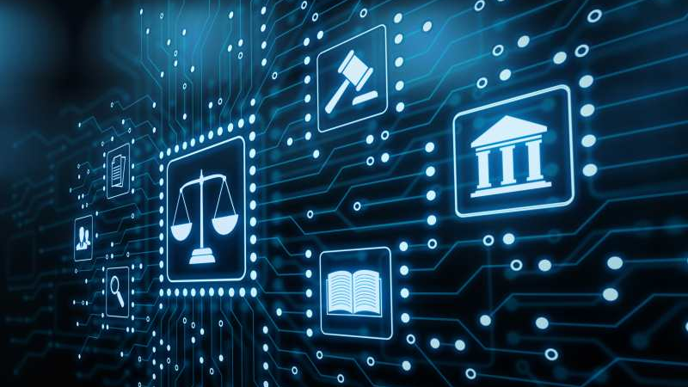
Disadvantages of Digital Forensics
Digital evidence accepted into court. However, it is must be proved that there is no tampering
Producing electronic records and storing them is an extremely costly affair
Legal practitioners must have extensive computer knowledge
If the tool used for digital forensic is not according to specified standards, then in the court of law, the evidence can be disapproved by justice.

Slide 11

Thanks for listening...

